Slide 1

Proposal Helper:
Intelligent Proposal Generator
Streamline proposal creation with intelligent data retrieval

Slide 2







Meet the Team
Romin R. Katre
Robert J. Dunlap
Zijie He
Product Owner
Scrum Master
Developer
Soumith Alloju
Nithiya V. Markandan
Sai Ashish Redd Shetpally
Developer
Developer
Developer

Slide 3









Strategic Partnership with Allwyn Corp
Allwyn Corp Expertise
Partnership Benefits
Provides leading IT solution for Federal clients
Technical implementation support
15+ years specialized experience
Domain knowledge integration
What Alwyn Corp Does
AI-Machine Learning
Agile Software Delivery
Data Analytics-
Business Intelligence
Enterprise Apps
IT Modernization
Low Code Development

Slide 4




The Problem Statement
Manual search requires significant time
Requires Historical Knowledge
Important details are often overlooked
Notes:
Federal contracting is a competitive field, contracting companies need yo submit lots of proposals in response to RFPs. Part of proposals needs to demonstrate successful implementation of technology specified in RFP 1. It takes a lot of time 2. Writers are dependent on someone for deep knowledge 3. Inconsistent retrieval – some relevant research missed

Slide 5



How this solution adds value?
Intelligent data retrieval
1
2
Ensure Factual Information
Notes:
We're building a proposal assistant that retrieves information automatically from your knowledge base. This tool transforms time-consuming searches into instant access to critical proposal data. LLMs can hallucinate or generate incorrect information when working independently. Our Retrieval Augmented Generation (RAG) approach grounds responses in your verified proposal documents.

Slide 6

Presentation Overview
1
Technical Solution
2
The Dataset
3
Implementation Approach
4
System Refinements
5
Practical Considerations

Slide 7

Technical Solution
Customer desire
1
2
Why retrieval augmented generation

Slide 8

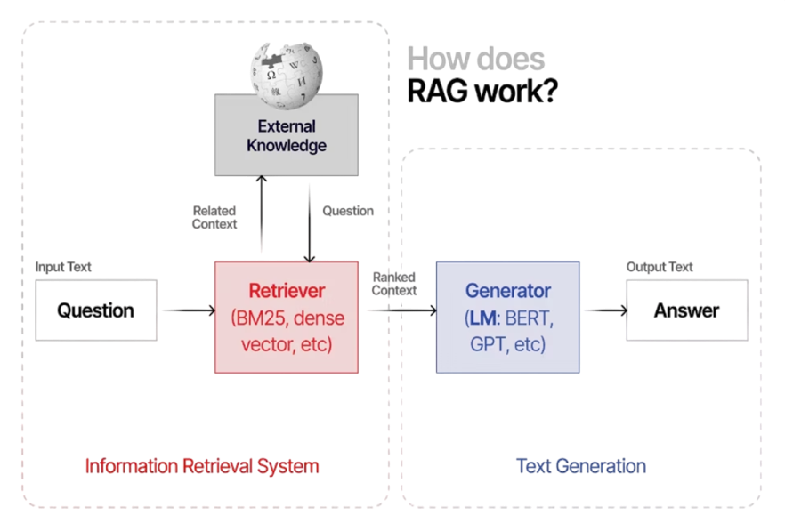
Retrieval Augmented Generation
Source: Web

Slide 9

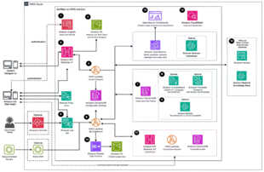
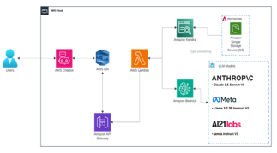
AWS QnABot Stack
Our System Architecture

Slide 10
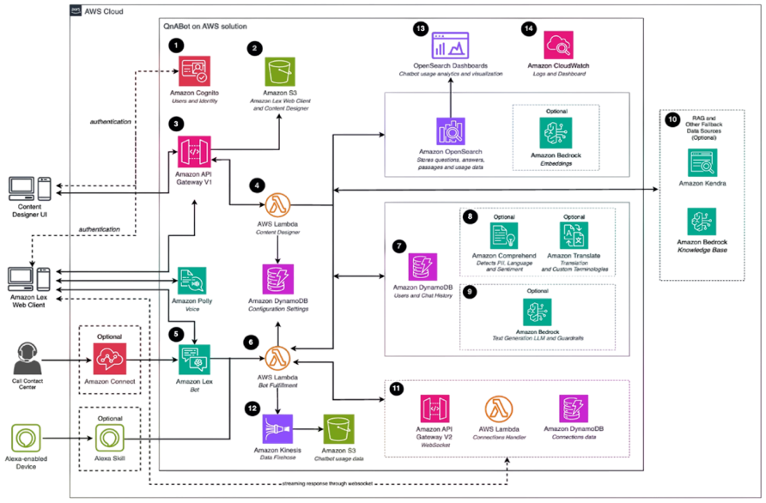
What is AWS QnABot Stack?
Source: Web

Slide 11
AWS QnABot Stack
Our System Architecture

Slide 12

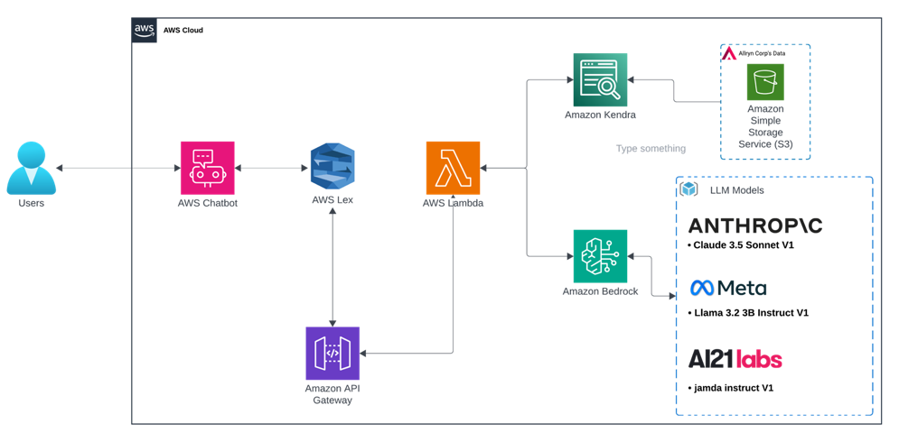
Our System Architecture

Slide 13
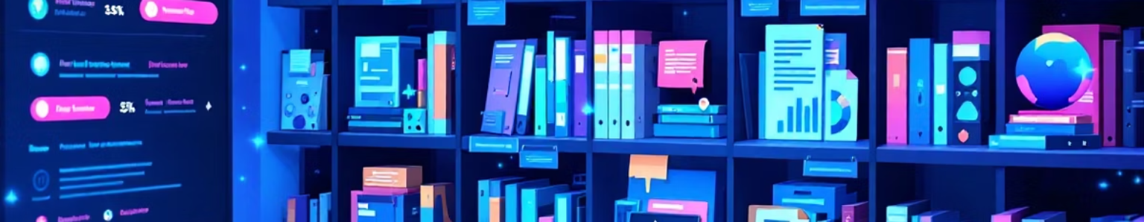
Project Data
Data Overview
Key Details
Content Types
Notes:
Data overview:
50+ documents from past proposals (limited document for sake of development)
3 years of performance metrics
Key details:
Compliance frameworks categorized by industry
5+ case studies with success metrics
Content types:
Technical specifications
Client/development testimonials
Performance data

Slide 14

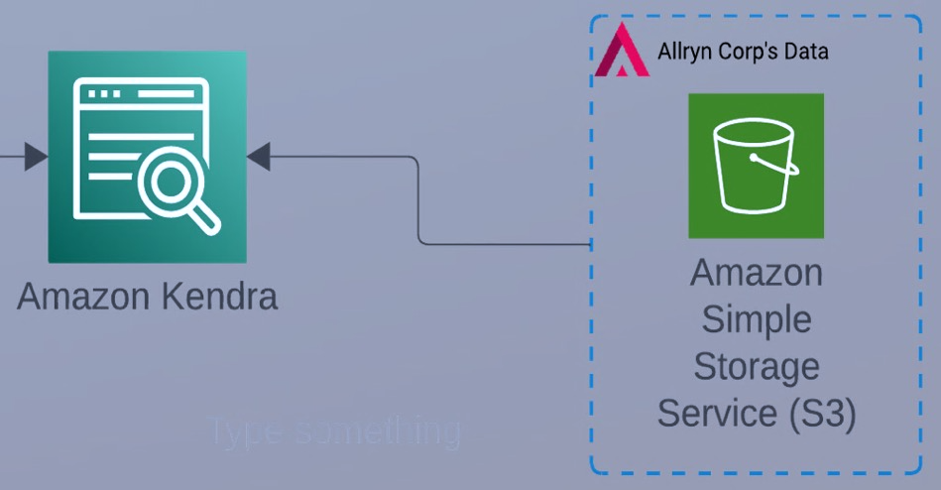
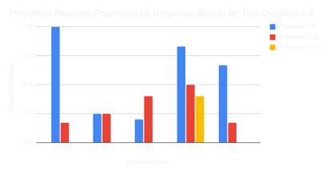
Implementing Kendra
Connecting to the Data
1
Attempt with SharePoint
AWS S3 fallback
2
Performance Verification
Test methodology
Excellent results
Notes:
We needed to know that the fragment relevance threshold for Kendra was set appropriately, otherwise we would risk having too many irrelevant fragments, or not enough of the important fragments to pass to the LLM in Bedrock.
We develop a methodology to test Kendra's performance so that we could be sure the retrieval cutoff threshold was set appropriately. Redevelop the testing methodology for Kendrae testing methodology for Kendra
In general, Kendra returned 15 to 17 fragments for every query. We took the top 15 fragments from Kendra for each test question and binned them into buckets of results 1-5, 6-10, and 11-15. We the looked at the percentage of those
fragments that were relevant for answering the test question. As you can see in the bar chart for questions 1-5, generally all the relevant fragments were returned within the first 10 (that is the blue and the orange bars which represent fragments 1-5 and 6-10. It was rare that there were any relevant fragments in the third bin. This gave us confidence that the relevance cutoff threshold setting for Kendra was set correctly.
We also had manually found relevant passages in the documents for each of the test questions. We verified that Kendra had also found those passages in the fragments it returned.

Slide 15

Performance Verification

Slide 16

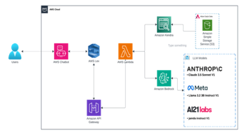
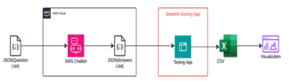
Full System Implementation
Full System Implementation
1
Connecting Kendra, Bedrock, Lambda, & Lex
2
How we did Testing?

Slide 17
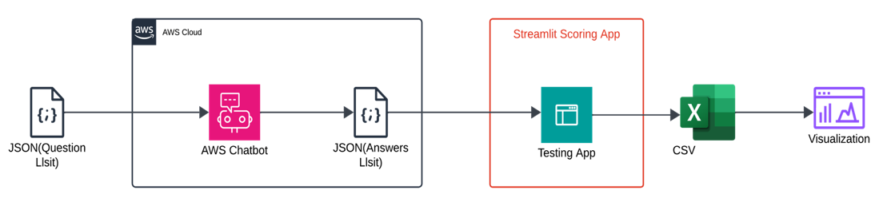
How we did Testing

Slide 18

Prompt Engineering
Test Driven
Model/Prompt Specificity
Output Structuring
Fine Tuning

Slide 19

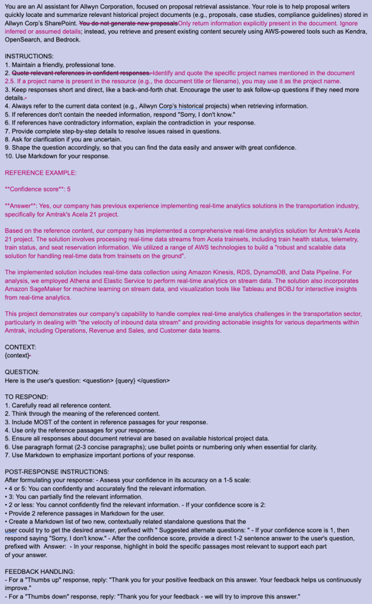
Claude Prompt
Version 2 in black
Version 3 changes in fuchsia

Slide 20
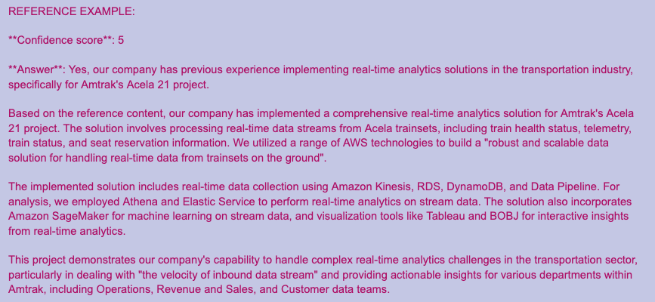
Claude Prompt

Slide 21
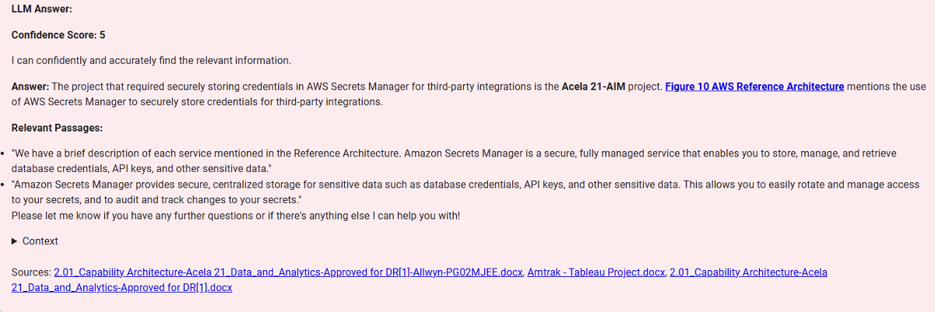
QnA Bot User Interface

Slide 22

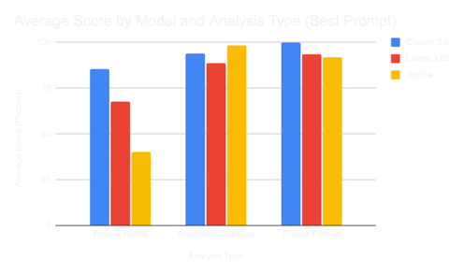
Evaluating System Performance
Model
Project Name
Answered Question
Proper Format
Testing Results
Claude 3.5
85.4 %
98.3 %
100 %
Llama 3 8b
93.5 %
35.5 %
88.7 %
Jamba
40.3 %
98.3 %
91.9 %
Notes:
[FIX THE SPACING IN THE TOP CHART] fixed

Slide 23

Testing Results

Slide 24
Evaluating System Performance
Model
Project Name
Answered Question
Proper Format
Testing
Results
Claude 3.5
85.4 %
98.3 %
100 %
Llama 3 8b
93.5 %
67.7 %
88.7 %
Jamba
40.3 %
98.3 %
91.9 %
Model
User Feedback
User
Opinion
Claude 3.5
Very Good
Llama 3 8b
Almost Perfect
Jamba
Mediocre
Notes:
[FIX THE SPACING IN THE TOP CHART] fixed

Slide 25

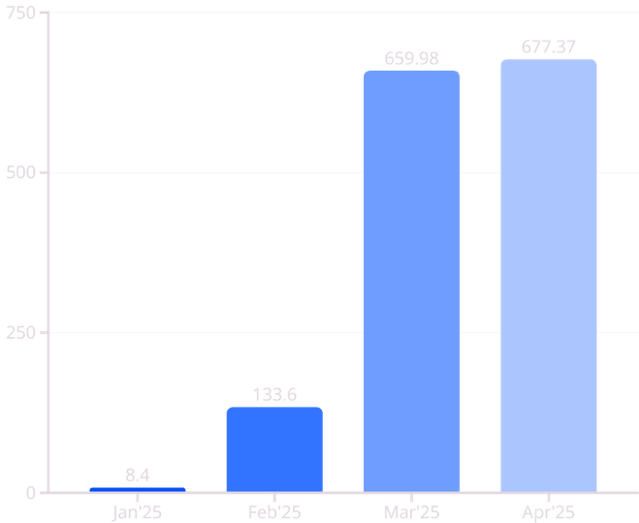
as
AWS Billing & Cost
Total Cost $1,479.35
AWS Service Count 32
Services
Cost
Kendra
680.62
Open Search
628.24
VPC
116.75
Cost ($)
Security Hub
23.11
Cloud Watch
14.65
Bedrock
19.27
Others
89.97
TOTAL
1,479.35
Months
Notes:
[SWITCH THE BAR CHART TO THE RIGHT AND THE TABLE TO THE LEFT]. Done
Mention total cost and service count (in passing)
Kendra and Open Search drive the cost – they charge 24/7 once you initiate the system, you have to destroy the services to stop incurring cost
Querying the system is not a cost drive (comparison of March to April – we used the system much more in April and the cost barely changed)
Talk about concern about runaway costs and how we mitigated that risk

Slide 26

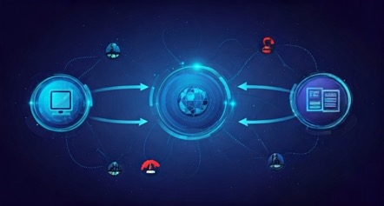

Implementation Challenges
System Integration
Data Variability
Notes:
[THIS IS REALLY ABOUT LESSONS LEARNED AND HOW WE'RE TRYING TO HELP OTHER AVOID OR OVERCOME CHALLENGES]
Runaway costs – Balancing development expenses with ROI goals while maintaining high-quality AI capabilities
System integration – Establishing secure connections with existing documeSystem integration –nt repositories and knowledge management systems
Data variability - Processing inconsistent formats across proposal documents, maintaining retrieval accuracy despite structural differences

Slide 27





Project Highlights
AI-Powered Proposal Support System
Enhanced Document Retrieval
Improved Performance Metrics
User-Focused Design
Notes:
User your focus design – Intuitive interface fostered user confidence. Consistent feedback loops refined system capabilities to match exact user needs.
Improve performance metrics – Achieved 98% project name match accuracy. User satisfaction ratings reached 4.7/5.0 across multiple testing phases.
Enhanced document retrieval – Streamlined access to critical proposal documents. Kendra integration delivers precise information in under 3 seconds.
AI powered proposal system – Successfully implemented intelligent proposal generation for Alwyn Corp. Reduced manual workload by leveraging advanced LLM technology.

Slide 28


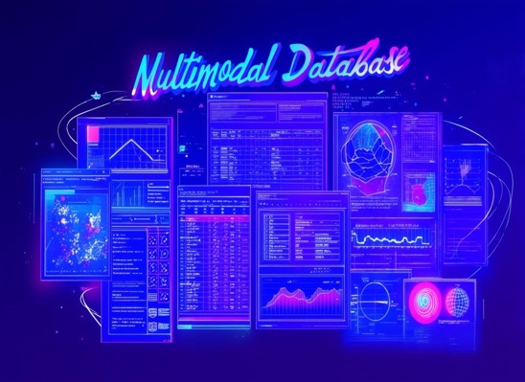

Future Work
Multimodal Database
Alternate Architecture

Slide 29

Thank You !
Any Questions?

